Slide 1
Endsem Project Presentation
Classification of Online News Articles based on Popularity

Slide 2
MOTIVATION

Slide 3
Understanding and predicting the popularity of online news articles is crucial for content creators, marketers, and media outlets.
Accurately forecasting the popularity of news articles can help in optimizing content distribution, enhancing engagement, and tailoring marketing strategies.
Accurate forecasting of online popularity rates can be achieved using various analysis techniques and machine learning algorithms.

Slide 4
LITERATURE REVIEW

Slide 5
Online News Articles Popularity Prediction System Riya Talwar, Apoorva Sharma, Nishita Badola, Lakshay , Yamini
The paper by presents an overview of binary classification models, providing insights into their configuration and characteristics. Here's a concise summary of each model:
A. Linear Regression: Used for binary classification by converting predicted shares to a classification result based on a threshold. Utilizes all 58 predictive features. Assumes feature independence and linear class separability, not ideal for classification. B. Logistic Regression: Selects the top 20 features using Recursive Feature Elimination (RFE). Employs a non-linear sigmoid activation function for contrast. Utilizes L2 regularization. C. Support Vector Machine (SVM): Employs RFE for feature selection and uses an RBF kernel with C = 10. Chose RBF for better accuracy. Provides good generalization but has longer computation times and lacks probabilistic confidence. D. Random Forest: Uses 100 decision trees, considering a maximum of 6 features at each node. Known for good generalization and non-overfitting, learning non-linear hypotheses. E. Adaboost Classifier: Utilizes decision stumps as base estimators. Found the best performance with 100 decision stumps using bagging and boosting. Achieved the best performance among the classifiers. F. K-Nearest Neighbors (KNN): Determines the class based on majority votes from k nearest training samples. The optimal k value is selected through a search for the best AUC score. Robust to feature value fluctuations, but choice of distance metric depends on the features. The paper provides a comprehensive overview of these models, their configurations, strengths, and weaknesses in binary classification.
The paper concluded with the usage of Support Vector Regression and Neural Networks, which provided an accuracies of around 70%

Slide 6
A Proactive Intelligent Decision Support System for Predicting the Popularity of Online News Kelwin Fernandes, Pedro Vinagre ,and Paulo Cortez
The study examined five classification models: Random Forest (RF), AdaBoost, Support Vector Machine with an RBF kernel, K-Nearest Neighbors (KNN), and Naïve Bayes (NB). These models were thoroughly evaluated and compared, providing insights into their strengths and weaknesses.
To enhance model performance, grid search techniques were employed. Random Forest and AdaBoost were tuned by systematically exploring the hyperparameter space, focusing on the number of trees. Similarly, SVM with an RBF kernel and KNN underwent an exhaustive search to optimize the C trade-off parameter and the number of neighbors.
During grid search, the training data was thoughtfully divided, with 70% allocated to the training set and 30% reserved for validation. Random Forest (RF) emerged as the top-performing model, achieving an impressive ROC Area Under the Curve of 73%, indicating its acceptable discrimination ability.
An in-depth analysis of the RF model's inputs highlighted the importance of keyword-based features, followed by Natural Language Processing (NLP) features and historical shares of Mashable links. These insights reveal critical factors contributing to the model's predictive accuracy.

Slide 7
DATASET DESCRIPTION

Slide 8
Data Set Description
This dataset summarizes a heterogeneous set of features about articles published by Mashable in a period of two years. The goal is to predict the number of shares in social networks (popularity).
The dataset contains various features extracted through natural language process techniques.

Slide 9
Data Set Description
The unique and non-unique tokens in the title, article, metadata.
They also include the number of images, videos, hyperlinks to both Mashable and non-Mashable articles.
Various categories of the maximum, minimum and mean shares of the best and worst keyword have been analysed as well.
Global Subjectivity scores have been provided for each article that determine the performance of opinion pieces versus reporting facts. Several metrics for Global Sentiment Polarity have been provided as well, such as rate of positivity and negativity and the maximum, minimum and mean values for the same.
The day of the week of article publishing has been provided and whether the article was published on a weekend or weekday.
Finally Latent Dirichlet Allocation was performed that subdivided the data into 5 topics.

Slide 10
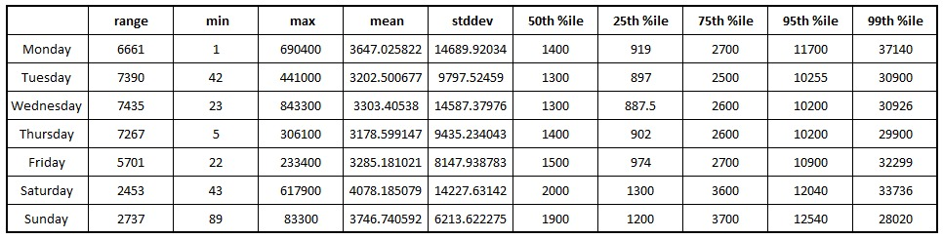
Data Set Description
Weekends perform consistently better till the 75th percentile. At the 95th percentile Monday also performs well.

Slide 11
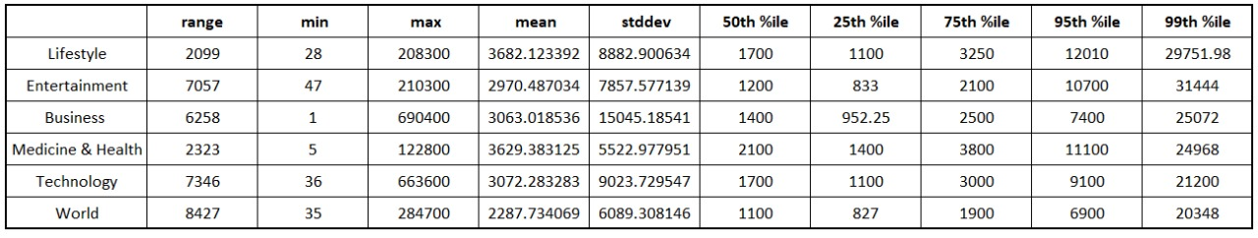
Data Set Description
Gives us a rough estimate of how well different subjects perform.

Slide 12
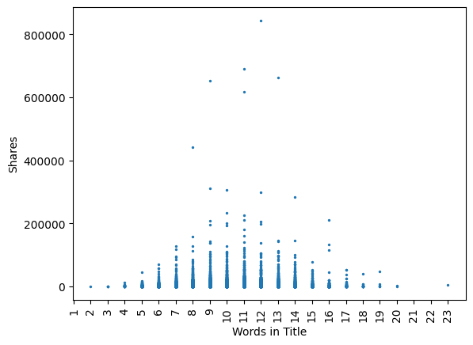
Data Set Description (Some Visualizations)
For shares within 150,000 range (i.e. in the non outlier range). We observe a normal distribution around 10-11 world in the title being the mean.

Slide 13
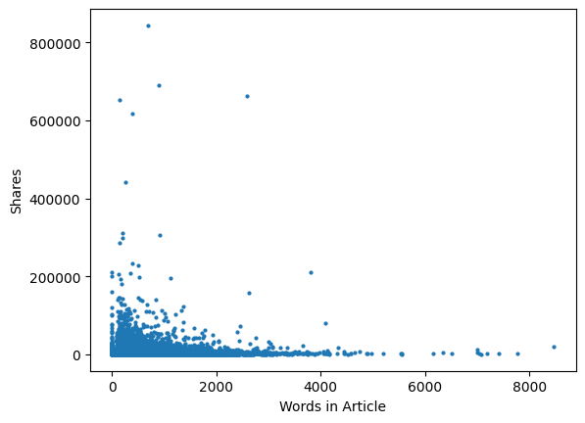
Data Set Description (Some Visualizations)
Words in the Article on the other hand for values within non outlier range, actually shows a distribution, that is closer to exponential for the most part. With the most popular articles being within the range of a few hundred words. i.e. shorter articles

Slide 14
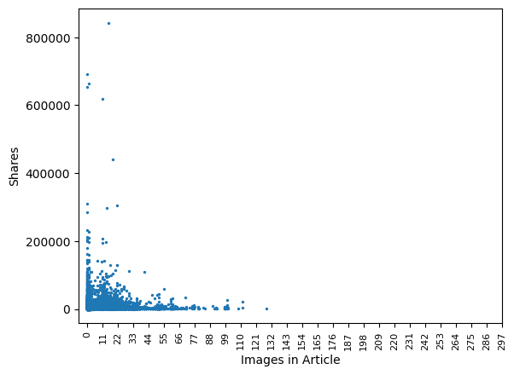
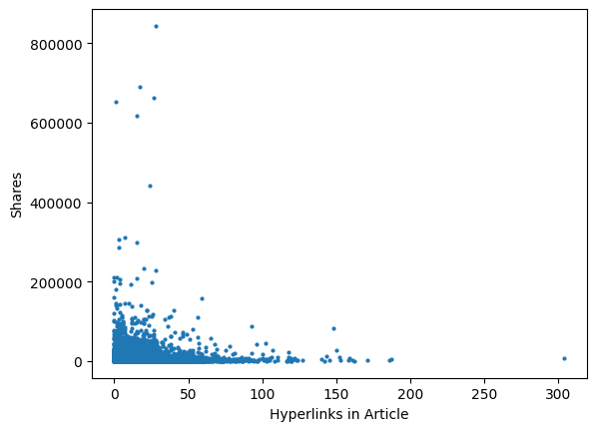
Data Set Description (Some Visualizations)
Similar distributions for images and hyperlinks as well, confirmed by our correlation coefficients.

Slide 15
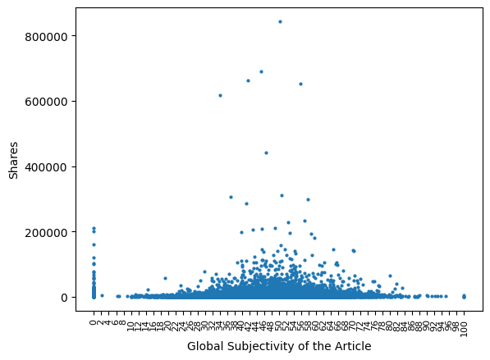
Data Set Description (Some Visualizations)
Global Subjectivity is similar to a gaussian distribution around 50 (suggesting a balance between factual articles and opinion pieces). But also a significant 0 score (purely factual) articles have a highly varied score.

Slide 16
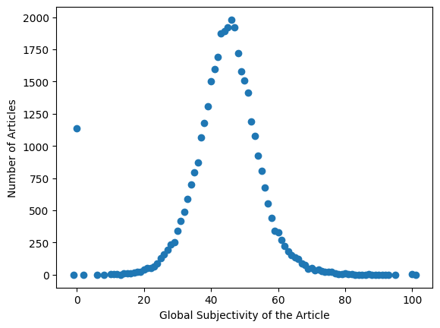
Data Set Description (Some Visualizations)
The frequency of articles also suggests a similar pattern as with the number of shares against the subjectivity score.

Slide 17
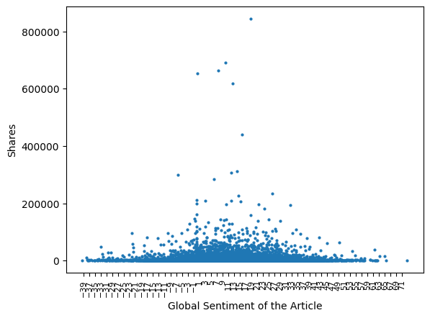
Data Set Description (Some Visualizations)
Global Sentiment on the other hand has a flatter gaussian suggesting a varied consumption of positive, negative and neutral articles.

Slide 18
Pre-Processing of Data
As observed in the dataset description, the dataset has some redundancies and some wasteful features. We perform pre-processing to improve the performance on the dataset.
We utilise techniques such as removing outliers, confounding variables and performing dimensionality reduction.

Slide 19
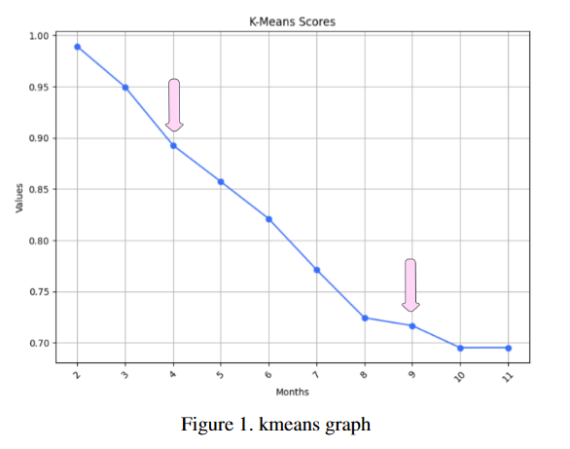
Converting continuous to discrete output
Number of clusters were decided using the ‘elbow’ in the k-means clustering graph. The values of k in the cluster were utilized and the one giving best accuracy (k=4) was selected.
We then used percentile approach to spilt the dataset into 4 classes.

Slide 20
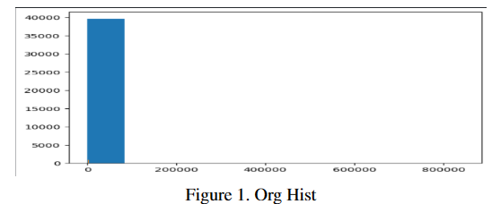
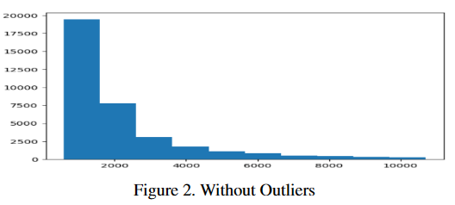
Removing outliers (based on output values)
By the histogram of the data, we can see that the dataset has some drastically low values and drastically large values, which can be treated as outliers.
Hence, we have removed 5% of samples with the lowest values of shares, and 5% of samples with the highest, to interpret the actual distribution of the sample values.

Slide 21
Removing non-predictive attributes
Subjects of Article
Attributes present just for the identification of the sample and had no predictive value were removed:
URL: URL of the article
Articles belong to six different categories - Life, Medicine, Tech, Entertainment, Business,World.
After plotting the violin plots of the categories,we realise that articles perform better in the following categories -
Life ≥ Medicine ≥ Tech ≥ Entertainment ≥ Business ≥ World

Slide 22
Dealing with Weekdays and Weekends
Removing the average attributes due to high correlation
All the weekdays perform equally after removing the outliers.
The attribute ‘is weekend’ gives enough information to interpret the weightages of days in predicting the number of shares.
All the other attributes are removed from the dataset.
We can see in multiple fields like keyword share rate, polarity rate, we can see that three attributes - max, min, as well as average are given.
However, in these cases, average has high correlation (above 0.5 and in some cases around 0.9) with the min-max attributes, which is not desirable.
Hence, we have removed the average attributes and left the min-max attributes.

Slide 23
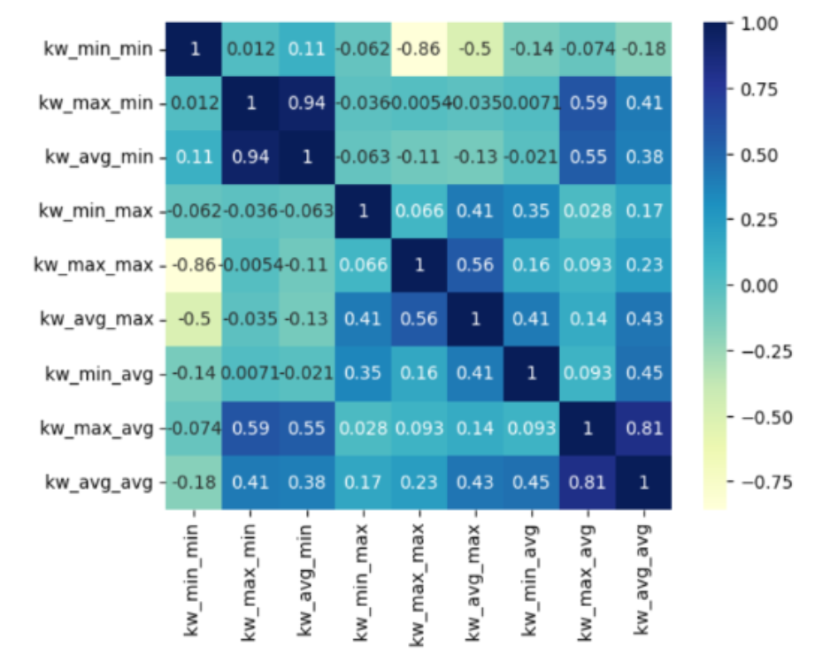
Correlation Heatmap of Average, Maximum and Minimum Keyword attributes

Slide 24
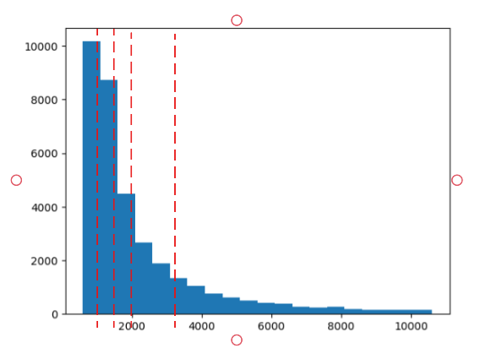
Transforming output data to Classes
We needed to define some classes in order to transform the task into a classification problem.
We have used a percentile based approach to divide our data into 5 classes.

Slide 25
Standardizing the dataset
Local Outlier Factor
The dataset was standardised using the mean and variance of the samples.
Z = (X − µ)/σ
Used for removing outliers.

Slide 26
METHODOLOGY

Slide 27
Multiclass Logistic Regression
What is Multiclass Logistic Regression?
Extends binary logistic regression to handle multiple classes.
Obtains a linear combination of the input features.
Linear combination is converted into a probability using a logistic function.
We define a decision boundary to obtain our output.

Slide 28
Multiclass Logistic Regression
Advantages:
Computationally efficient, suitable for large datasets, easy to interpret, low memory footprint, easy to implement, efficient with high dimensional data, probabilistic output.
Implementation:
Used StandardScaler for feature scaling
Used PCA to reduce the number of components
Applied built-in multinomial LogisticRegression from sklearn
Ran the model for a maximum of 10000 iterations

Slide 29
Random Forest Classifier
What is Random Forest?
Efficient machine learning algorithm
Amalgamates outputs from multiple decision trees.
Result is the mode of individual tree outputs.
Advantages:
High accuracy, robust to overfitting, implicit feature selection, parallelization, handles missing values, works well with imbalanced data, out-of-bag error estimation, versatile.

Slide 30
Random Forest Classifier
Implementation:
Used StandardScaler from sklearn to standardise our data.
Used LocalOutlierFactor to remove outliers.
Applied PCA to reduce the number of components
Used the built-in RandomForestClassifier from sklearn
We used 100 decision trees for our classifier.

Slide 31
Gaussian Naïve Bayes(GNB)
What is GNB?
Probabilistic Classifier: Utilizes probability theory to classify data based on the Gaussian distribution assumption for feature likelihoods.
Gaussian Distribution Assumption: Assumes that features within each class follow a Gaussian (normal) distribution.
Naive Independence Assumption: Assumes independence between features, simplifying computations despite the potentially correlated nature of real-world data.
Efficient Computation: Performs calculations efficiently, making it suitable for high-dimensional datasets and real-time applications.
Effective for Continuous Data: Particularly effective when dealing with continuous or real-valued features.
Widely Used for Classification: Commonly applied in classification tasks, especially when the data distribution aligns with Gaussian characteristics.

Slide 32
Gaussian Naïve Bayes(GNB)
Advantages:
Simple and Fast: Gaussian Naive Bayes is computationally efficient and easy to implement, making it suitable for quick prototyping and processing large datasets.
Effective for Continuous Features: Particularly effective when dealing with continuous or real-valued features due to its assumption of Gaussian distribution.

Slide 33
Gaussian Naïve Bayes(GNB)
Implementation:
Pre-processing- No preprocessing needed since the variables were already independent of each other.
Standardization is done internally in the Gaussian Naïve Bayes, hence it wasn’t performed on the dataset.

Slide 34
Support Vector Machines (SVM)
What is SVM?
Effective in High-Dimensional Spaces: Support Vector Machines (SVM) work well in high-dimensional spaces, making them suitable for problems with many features.
Kernel Trick: SVM can handle both linear and non-linear relationships through the use of kernel functions, allowing it to capture complex patterns in the data.
Robust to Overfitting: SVM is less prone to overfitting, especially in high-dimensional spaces, thanks to the margin maximization objective.
Versatile Kernel Options: SVM supports various kernel functions, such as linear, polynomial, and radial basis function (RBF), enabling flexibility in capturing different types of relationships in the data.
Effective in Small Sample Size: SVM can perform well even with a relatively small dataset, making it suitable for scenarios with limited labeled data.

Slide 35
Support Vector Machines (SVM)
Advantages:
Effective in High-Dimensional Spaces: SVMs perform well in datasets with a high number of features, making them suitable for complex problems with many variables.
Robust to Overfitting: SVMs are less prone to overfitting, providing good generalization even in situations with relatively small datasets. The margin maximization principle helps in achieving a balance between fitting the training data and avoiding excessive complexity.

Slide 36
Support Vector Machines (SVM)
Implementation:
Split the dataset into training and testing sets
Used StandardScaler to standardize the data
Used SVC(SVM classifier) from sklearn with linear kernel and C=1
Used accuracy_score from sklearn to calculate the model accuracy
Performed 10-fold cross validation on the data

Slide 37
Results and analysis
Model | Standard Accuracy | 10-Fold Cross Validation
Multiclass Logistic Regression | 80% | 72%
Random Forest | 98% | 84%
Gaussian Naïve Bayes | 89.24% | 89.23%
Support Vector Machine | 97.92% | 87.2%

Slide 38
Results and analysis
Random Forest Classifier and Support Vector Machine (SVM) demonstrated exceptional accuracy, achieving approximately 0.97, whereas the Gaussian Naive Bayes (GNB) classifier achieved an accuracy of 0.89.
During 10-fold cross-validation, the GNB Classifier maintained its accuracy at 0.89, whereas the other models experienced a decrease of nearly 0.1 in accuracy.
This divergence can be attributed to the inherent robustness of GNB against overfitting, a quality not shown by the other models.

Slide 39
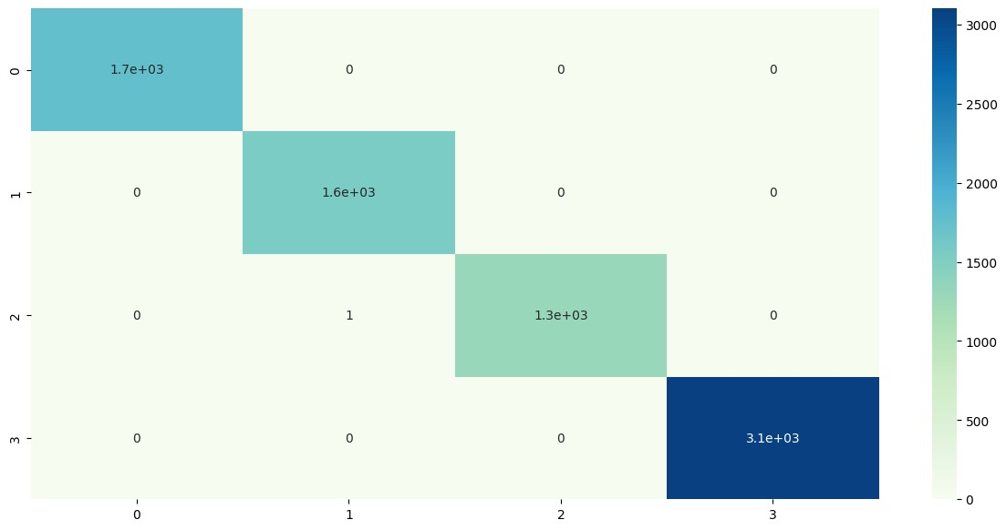
Results and analysis
Random Forest

Slide 40
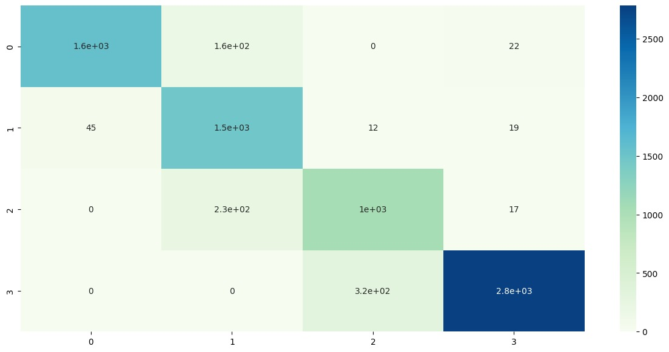
Results and analysis
Gaussian Naive Bayes

Slide 41
Individual Contributions
Literature Review - Abhishek Sushil
EDA and Data Preprocessing - Abhishek Sushil and Ayush Srivastava
Model Selection and Implementation - Ayush Srivastava and Manas Narang
Model Result Analysis and Conclusion - Anurag Gupta and Manas Narang

Slide 42
Thank you

